Slide 1

openSUSE Cloud Storage Workshop
AvengerMoJo ( Alex Lau alau@suse.com )
Nov, 2016

Slide 2
Storage Intro
Traditional Storage

Slide 3
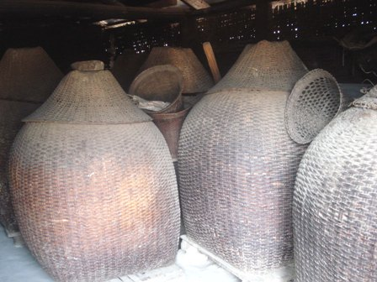
Google: Traditional Storage

Slide 4
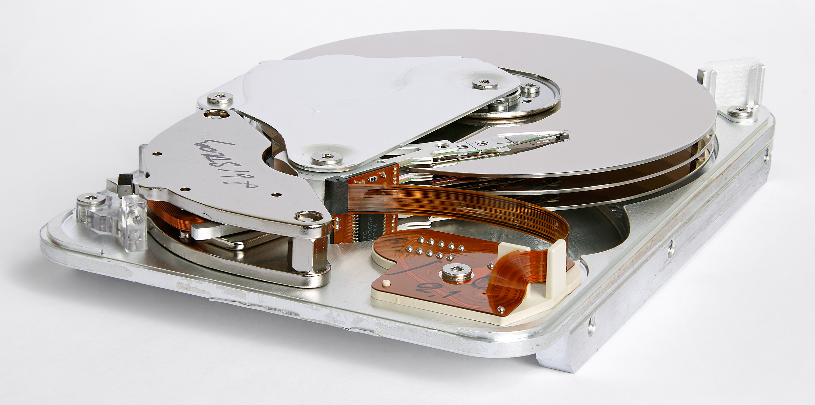
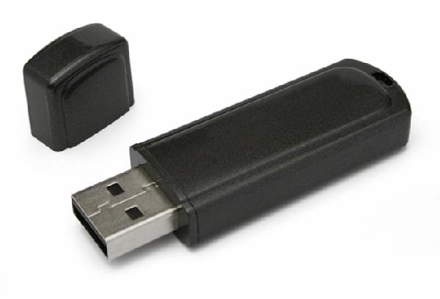
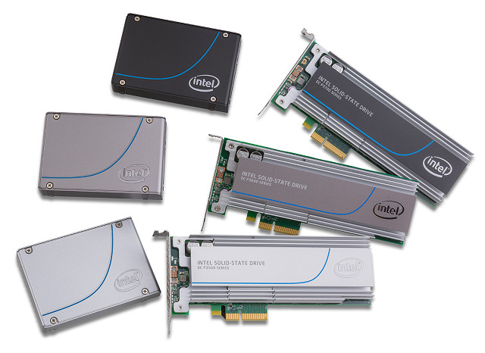
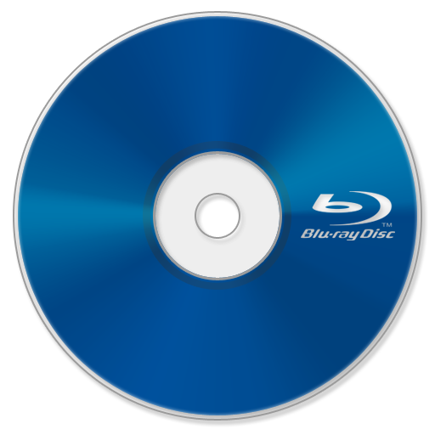
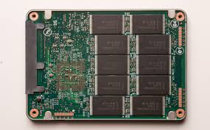
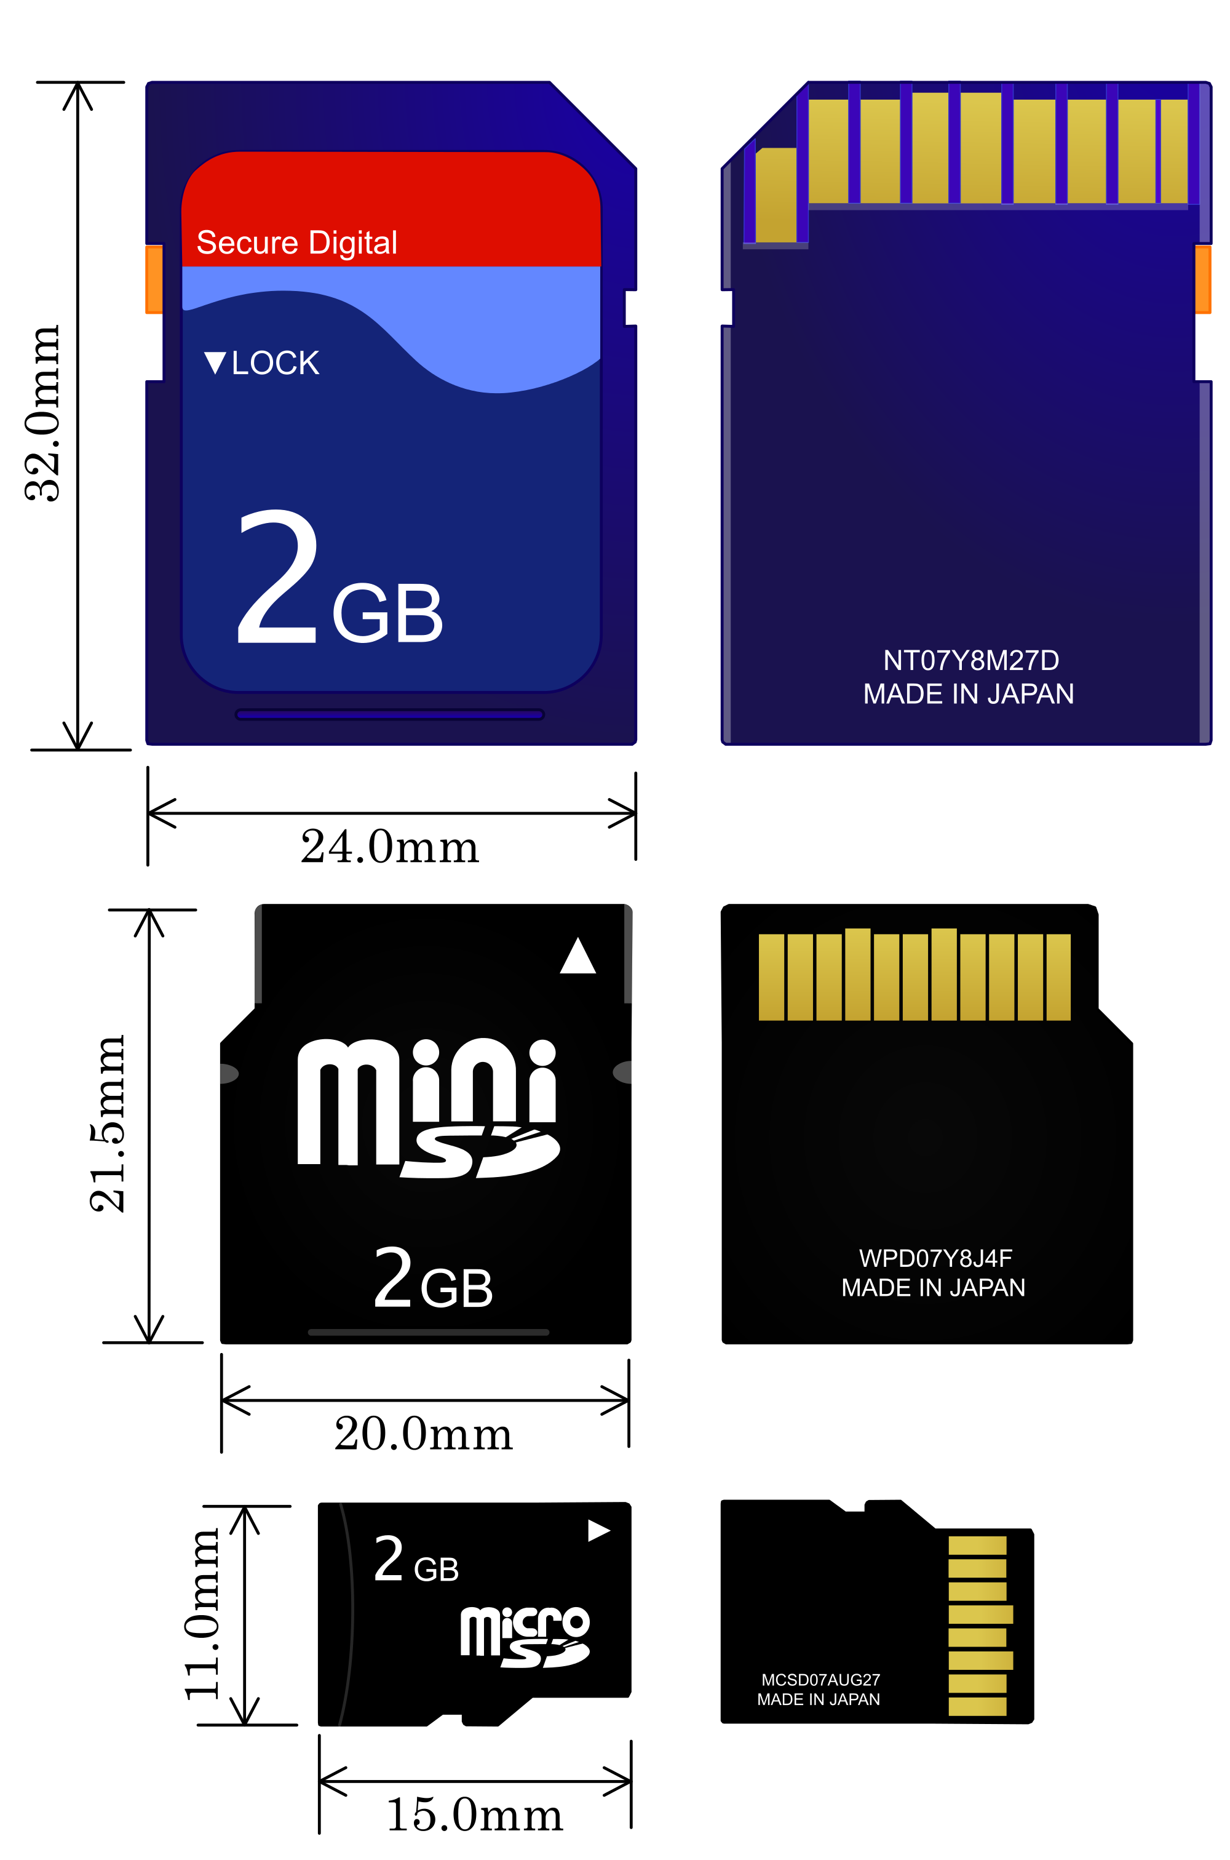
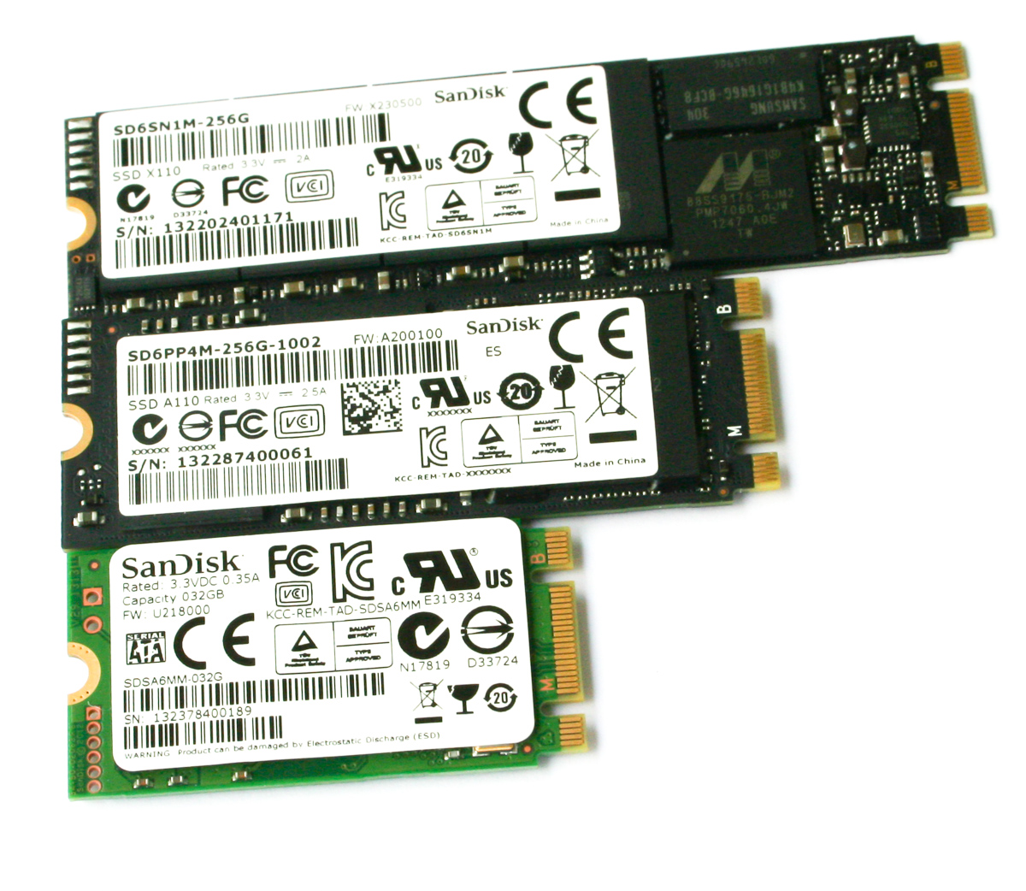
Storage Medium Secondary Storage

Slide 5
Storage Size Bits and Bytes
Bytes (B)
Kilobyte (KB)
Megabyte (MB)
Gigabyte (GB)
Terabyte (TB)
Petabyte (PB)
Exabyte (EB)
8 Bits
1,024 Bits
1,048,576 Bits
1,073,741,824 Bits
1,099,511,627,776 Bits
1,125,899,906,842,624 Bits
1,152,921,504,606,846,976 Bits

Slide 6
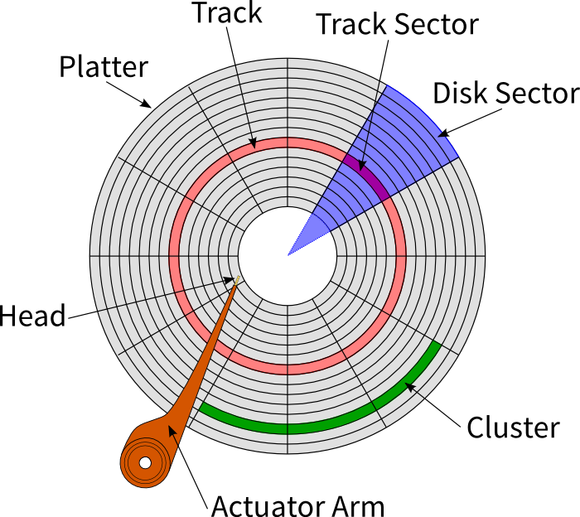
Hard Driver Terms
Capacity ( Size )
Cylinders, Sectors and Tracks
Revolution per Minute ( Speed )
Transfer Rate ( e.g. SATA III )
Access Time ( Seek time + Latency )

Slide 7
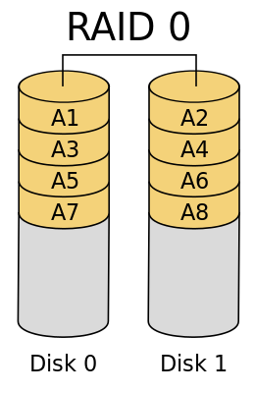
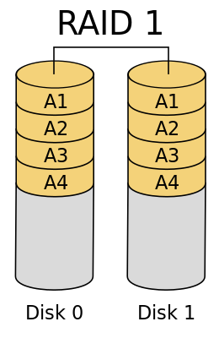
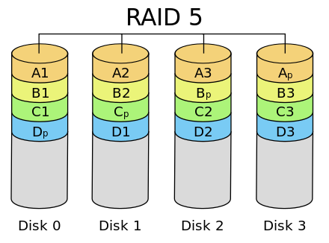
RAID
Redundant Array of Independent Disks
2 or more disks put together to act as 1

Slide 8
NAS and SAN
Network Attached Storage
TCP/IP
NFS/SMB
Serve Files
Storage Area Network
Fiber Channel
ISCSI
Serve Block ( LUN )

Slide 9
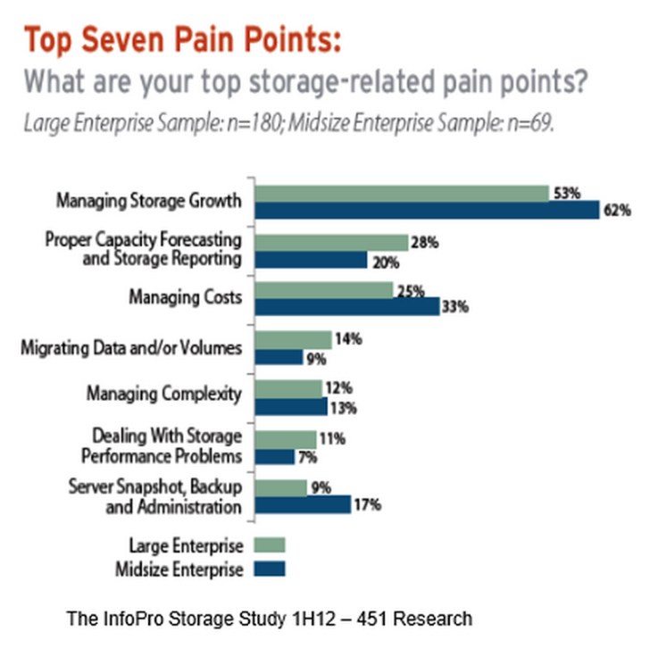
Storage Trend
Data Size and Capacity
Multimedia Contents
Big Demo binary, Detail Graphic / Photos, Audio and Video etc.
Data Functional need
Different Business requirement
More Data driven process
More application with data
More ecommerce
Data Backup for a longer period
Legislation and Compliance
Business analysis

Slide 10
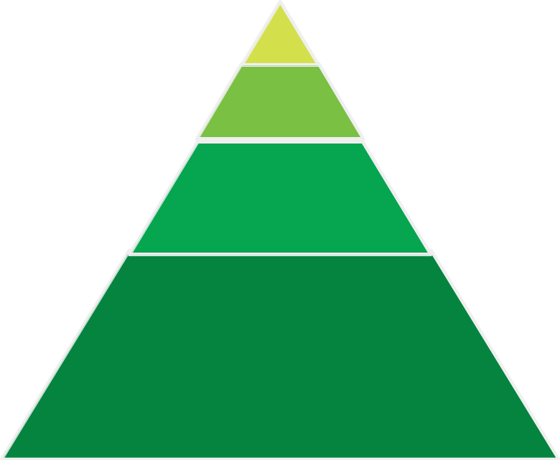
Storage Usage
Ultra High
Performance
1-3%
Tier 0
High-value, OLTP,
Revenue Generating
15-20%
Tier 1
Backup/Recovery,
Reference Data,
Bulk Data
20-25%
Tier 2
Object, Archive,
Compliance Archive,
Long-term Retention
50-60%
Tier 3

Slide 11
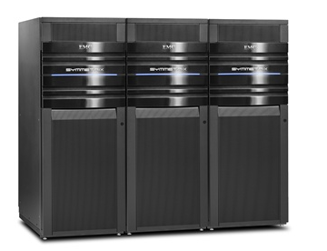

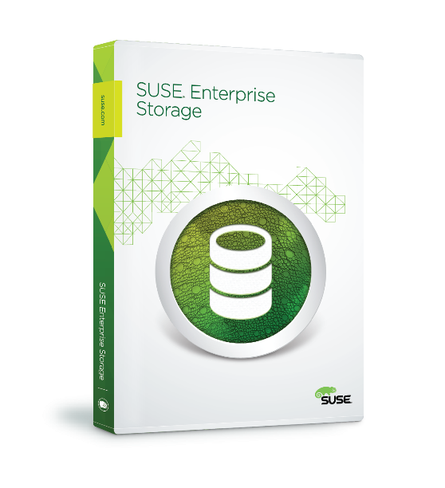
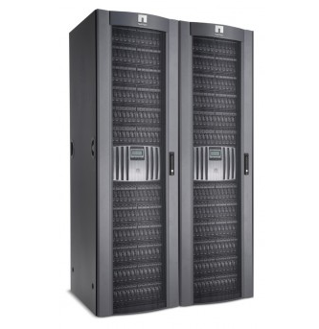
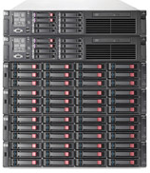
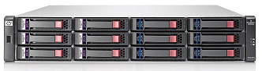
Storage Pricing
High-end
Disk Array
Dell EMC, Hitachi,
HP, IBM
Mid-range
Array
NetApp,
Pura Storage,
Nexsan
Fully Featured
NAS Device
Mid-range
NAS
Promise, Synology,
QNAP, Infortrend,
ProWare, SansDigitial
Entry-level
Disk Array
SUSE Enterprise
Storage
JBOD Storage
Notes:
11

Slide 12
Cloud Storage Intro
Software Define Storage

Slide 13






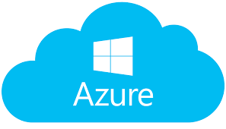


Who is doing cloud storage?

Slide 14
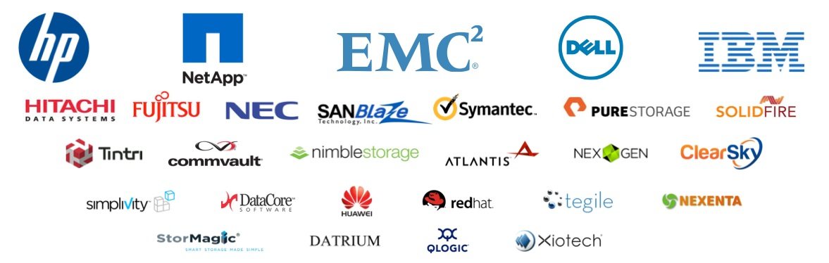

Who is doing Software Define Storage

Slide 15






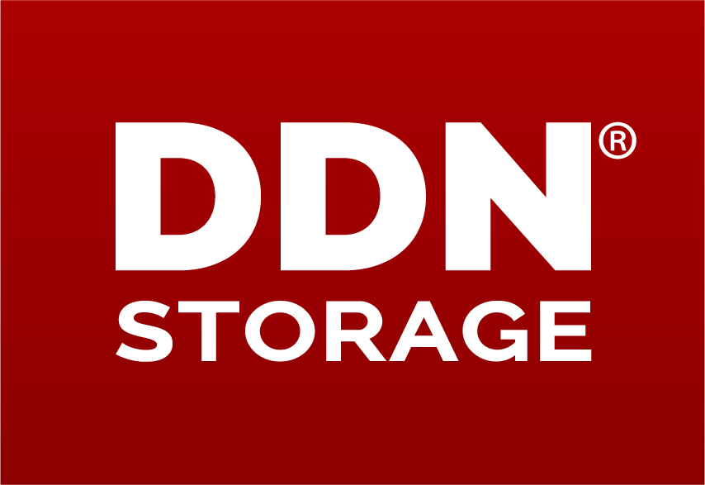






Gartner’s Report
Ability to Execute
Challengers
Leaders
http://www.theregister.co.uk/2016/10/21/gartners_not_scoffing_at_scofs_and_objects/
SUSE has an aggressive pricing for deployment with commodity hardware
SES make both ceph and openstack enterprise ready
Completeness of Vision
Niche
Visionaries

Slide 16
Software Define Storage Definition From http://www.snia.org/sds
Virtualized storage with a service management interface, includes pools of storage with data service characteristics
Automation
Simplified management that reduces the cost of maintaining the storage infrastructure
Standard Interfaces
APIs for the management, provisioning and maintenance of storage devices and services
Virtualized Data Path
Block, File and/or Object interfaces that support applications written to these interfaces
Scalability
Seamless ability to scale the storage infrastructure without disruption to the specified availability or performance
Transparency
The ability for storage consumers to monitor and manage their own storage consumption against available resources and costs

Slide 17
SDS characters SUSE’s Ceph benefit point of view
High Extensibility:
Distributed over multiple nodes in cluster
High Availability:
No single point of failure
High Flexibility:
API, Block Device and Cloud Supported Architecture
Pure Software Define Architecture
Self Monitoring and Self Repairing

Slide 18
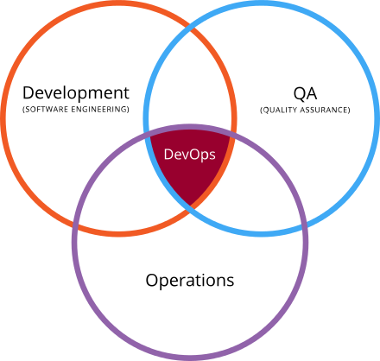
DevOps with SDS
Collaboration between
Development
Operations
QA ( Testing )
SDS should enable DevOps to use a variety of data management tools to communicate their storage
http://www.snia.org/sds

Slide 19
Why using ceph?
Thin Provisioning
Cache Tiering
Erasure Coding
Self Manage and Self Repair with continuous monitoring
High ROI compare to traditional Storage Solution Vendor

Slide 20
Thin Provisioning
Traditional Storage Provision
SDS Thin Provisioning
Allocated
Available
Storage
Volume B
Data
Allocated
Data
Volume B
Volume A
Data
Data
Volume A

Slide 21
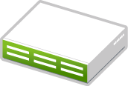
Cache Tiers
WriTE Application
Read Application
SUSE ceph Storage Cluster
Write Tier
Read Tier
Normal Tier
Normal Tier
Hot Pool
Hot Pool
Cold Pool
Cold Pool
Writing Quickly Application like:
e.g. Video Recording
e.g. Lots of IoT Data
Reading Quickly Application like:
e.g. Video Streaming
e.g. Big Data analysis

Slide 22
Erasure Coding
Multiple Copy of stored data
300% cost of data size
Low Latency, Faster Recovery
Single Copy with Parity
150% cost of data size
Data/Parity ratio trade of CPU
Object
Object
Control Costs
Control Costs
Copy
Copy
Copy
Data
Data
Data
Data
Parity
Parity
Replication Pool
Erasure Coded Pool
SES CEPH CLUSTSER
SES CEPH CLUSTSER
Notes:
As previously mentioned SUSE Enterprise storage is a highly scalable and highly available storage solution.
A SUSE Enterprise Storage Cluster is build using commodity server and disk drive components. Giving you freedom of choice to choose the hardware and significantly reduce capital cost by eliminating the need to purchase more expensive proprietary storage systems. Still your current investment is protected because different types and speeds of drives can be deployed dependent on your requirements. This could include flash drives for very high performance or high capacity hard disk drives for bulk storage.
[click]

Slide 23
Self Manage and Self Repair
CRUSH map
Controlled Replication Under Scalable Hashing
Controlled, Scalable, Decentralized Placement of Replicated Data
Object
Hash
Num of PG
CRUSH
Cluster state
Rule
OSD
Peer OSD
Local Disk

Slide 24
What is ceph?
Different components

Slide 25
Basic Ceph Cluster
Interface
File Store
CEPHFS
Interface
Object Store
Block
File
MON
Cluster map
OSD
Data storage
MDS
cephfs
Object Store
RADOSGW
RADOS
Block Store
RDB
OSD
MON
MDS
OSD
MON
MDS
LIBRADOS
OSD
MON
MDS

Slide 26
Ceph Monitor
Mon
Paxos Role
Proposers
Acceptors
Learners
Leader
Paxos Service
MON
MAP
OSD
MAP
PG
MAP
CRUSH
MAP
Paxos
LevelDB
Log
K/V
K/V
K/V
…

Slide 27
ObjectStore Daemon
OSD
Low level IO operation
FileJournal normally finished first before FileStore write to disk
DBObjectMap provide KeyValue omap for copy on write function
File
Store
OSD
OSD
OSD
PG
PG
PG
PG
…
Object Store
File
Store
FileJournal
DBObjectMap

Slide 28
FileStore Backend
RADOS
OSD
MON
OSD Manage its own consistency of data
All write operation are transactional on top of existing filesystem
XFS, Btrfs, ext4
ACID ( Atomicity, Consistency, Isolation, Durability ) operations to protect data write
OSD
MON
OSD
MON
OSD
OSD
OSD
File
Store
File
Store
File
Store
XFS
Btrfs
ext4
Disk
Disk
Disk

Slide 29

cephfs MeatData Server
MDS store data at RADOS
Directories, Files ownership, access mode etc
POSIX compatible
Don’t Server File
Only Required for share filesystem
High Availability and Scalable
Data
CephFS
Client
Data
Data
RADOS
OSD
MON
MDS
META
OSD
MON
MDS
OSD
MON
MDS

Slide 30
CRUSH map
Devices:
Devices consist of any object storage device–i.e., the storage drive corresponding to a ceph-osd daemon. You should have a device for each OSD daemon in your Ceph configuration file.
Bucket Types:
Bucket types define the types of buckets used in your CRUSH hierarchy. Buckets consist of a hierarchical aggregation of storage locations (e.g., rows, racks, chassis, hosts, etc.) and their assigned weights.
Bucket Instances:
Once you define bucket types, you must declare bucket instances for your hosts, and any other failure domain partitioning you choose.
Rules:
Rules consist of the manner of selecting buckets.

Slide 31
Kraken / SUSE Key Features
Client from multiple OS and hardware including ARM
Multi Path iSCSI support
Cloud Ready and S3 Supported
Data encryption over physical disk
Cephfs support
Bluestore support
Ceph-manager
openATTIC

Slide 32
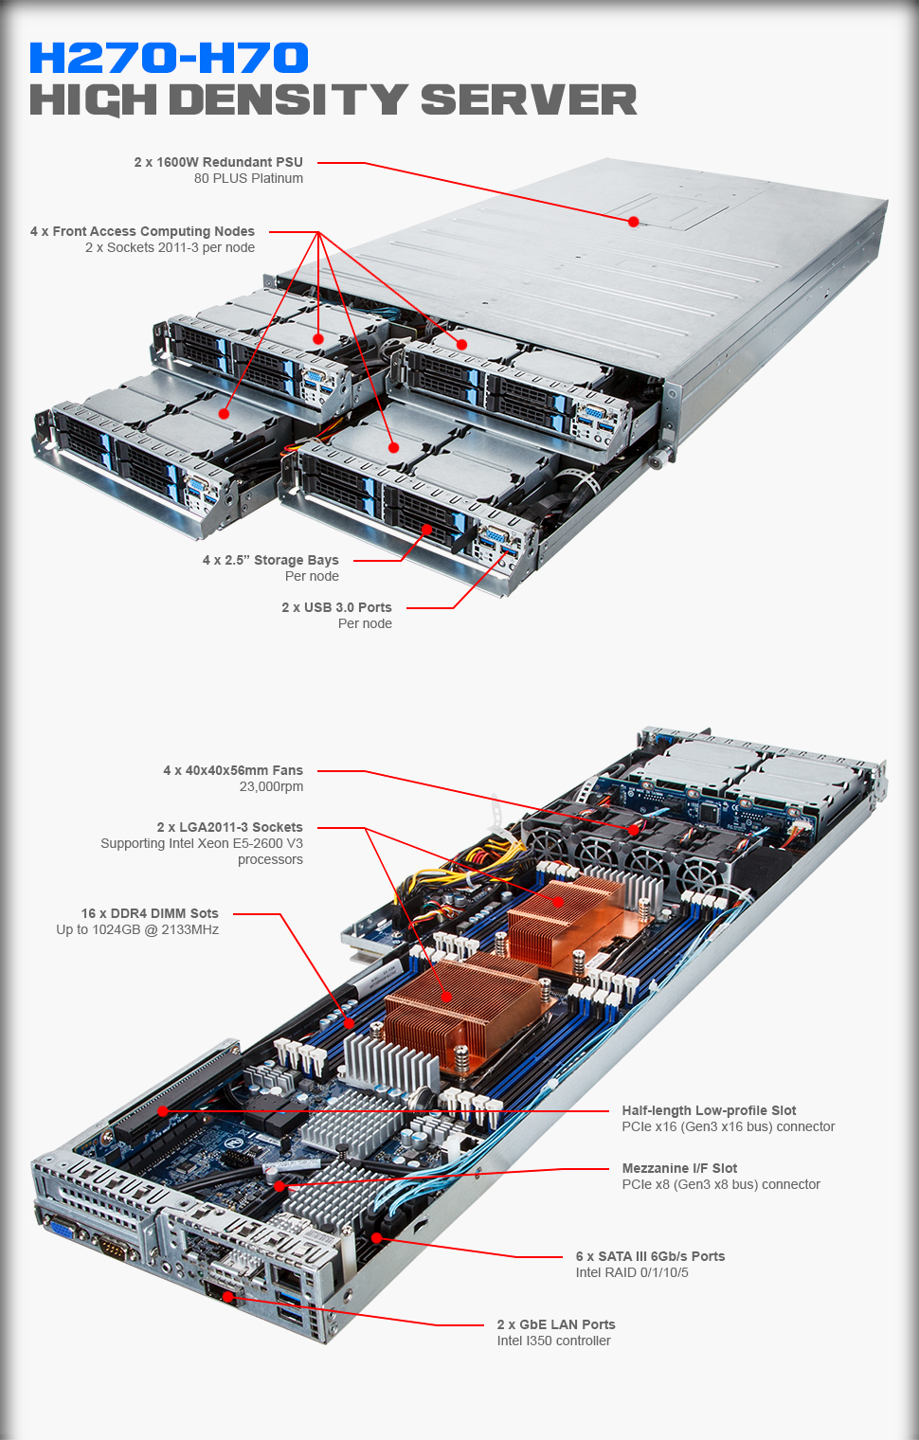
ARM64 Server
Ceph already been tested with the following Gigabyte Cavium system
Gigabyte H270-H70 Cavium
48 Core * 8 : 384 Cores
32G * 32: 1T Memory
256G * 16: 4T SSD
40GbE * 8 Network

Slide 33
iSCSI Architecture Technical Background
Protocol:
Block storage access over TCP/IP
Initiators the client that access the iscsi target over tcp/ip
Targets, the server that provide access to a local block
SCSI and iSCSI:
iSCSI encapsulated commands and responses
TCP package of iscsi is representing SCSI command
Remote access:
iSCSI Initiators able to access a remote block like local disk
Attach and format with XFS, brtfs etc.
Booting directly from a iscsi target is supported
Notes:
33
33

Slide 34

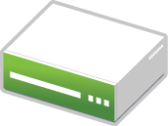



Cluster Network
OSD1
OSD2
OSD3
OSD4
RBD image
Public Network
RBD Module
RBD Module
iSCSI Gateway
iSCSI Initiator
iSCSI Gateway

Slide 35
BlueStore Backend
BlueStore
META
Rocksdb
Object metadata
Ceph key/value data
Block Device
Directly data object
Reduce Journal Write operation by half
Allocator
Data
RocksDB
Data
Data
BlueFS
Block
Block
Block

Slide 36
Ceph object gateway
RESTful gateway to ceph storage cluster
S3 Compatible
Swift Compatible
S3 API
LIBRADOS
RADOS
RADOSGW
OSD
MON
OSD
MON
Swift API
RADOSGW
OSD
MON

Slide 37
CephFS
Kernel cephfs.ko
FUSE cephfs
POSIX compatible
MDS provide metadata information
Kernel cephfs module and FUSE cephfs module available
Advance features that is still require lots of testing
Directory Fragmentation
Inline Data
Snapshots
Multiple filesystems in a cluster
libcephfs
RADOS
OSD
MON
MDS
OSD
MON
MDS
librados
OSD
MON
MDS

Slide 38

openATTIC Architecture High Level Overview
RESTful API
PostgreSQL
Django
HTTP
NoDB
DBUS
openATTIC SYSTEMD
librados/librbd
Ceph Storage Cluster
Shell
Web UI
REST Client
Linux OS Tools
Notes:
38
38

Slide 39
Hardware
What is the minimal setup?

Slide 40
Ceph Cluster in a VM Requirement
At least 3 VM
3 MON
3 OSD
At least 15GB per osd
Host device better be on SSD
>15G
>15G
>15G
OSD
OSD
OSD
MON
MON
MON
VM
VM
VM

Slide 41
Minimal Production recommendation
OSD Storage Node
2GB RAM per OSD
1.5GHz CPU core per OSD
10GEb public and backend
4GB RAM for cache tier
MON Monitor Node
3 Mons minimal
2GB RAM per node
SSD System OS
Mon and OSD should not be virtualized
Bonding 10GEb

Slide 42
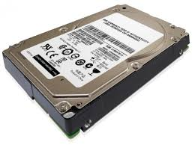
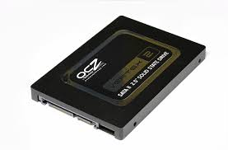
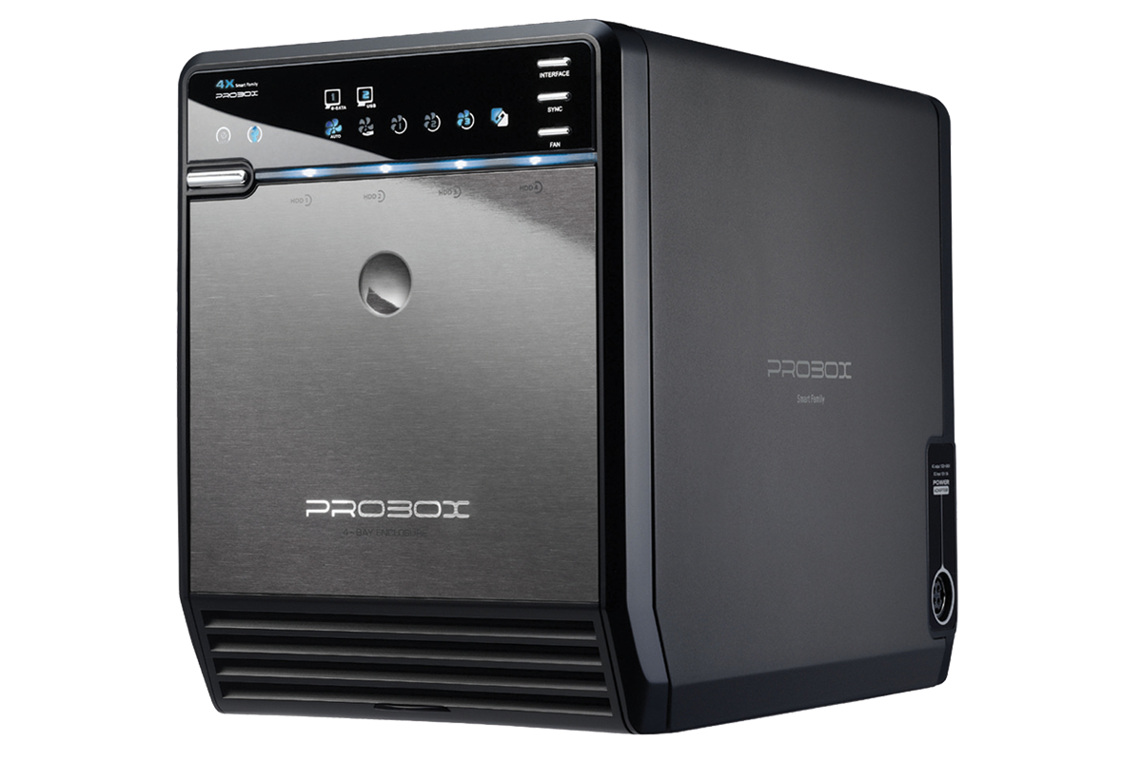
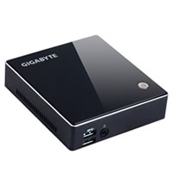
For developer
6T = 220$
220 * 3 = 660$
6T = 220$
220 * 3 = 660$
6T = 220$
220 * 3 = 660$
512G = 150$
512G = 150$
512G = 150$
OSD1
OSD2
OSD3
OSD4
OSD5
OSD6
OSD7
OSD8
OSD9
OSD10
OSD11
OSD12
300$
300$
300$
MON1
MON2
MON3
Dual 1G Network

Slide 43
HTPC AMD (A8-5545M)
Form factor:
29.9 mm x 107.6 mm x 114.4mm
CPU:
AMD A8-5545M ( Clock up 2.7GHz / 4M 4Core)
RAM:
8G DDR-3-1600 KingStone ( Up to 16G SO-DIMM )
Storage:
mS200 120G/m-SATA/read:550M, write: 520M
Lan:
Gigabit LAN (RealTek RTL8111G)
Connectivity:
USB3.0 * 4
Price:
$6980 (NTD)

Slide 44
Enclosure
Form factor:
215(D) x 126(w) x 166(H) mm
Storage:
Support all brand of 3.5" SATA I / II / III hard disk drive 4 x 8TB = 32TB
Connectivity:
USB 3.0 or eSATA Interface
Price:
$3000 (NTD)

Slide 45
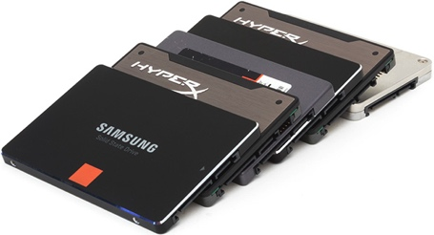
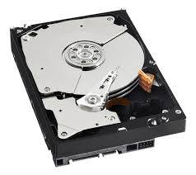
How to create multiple price point?
1000$ = 1000G 2000MB rw
4 PCIe = 4000$ = 8000MB rw
4T Storage 400,000 IOPS
4$ per G
250$ = 1000G, 500MB rw
16 Driver = 4000$ = 8000MB rw
16T Storage 100,000 IOPS
1$ per G
250$ = 8000G 150MB rw
16 Driver = 4000$ = 2400MB rw
128T Storage 2000 IOPS
0.1$ per G

Slide 46
ARM64 hardware compare to Public Cloud price
R120-T30 - 5700$ * 7
48 Core * 7 : 336 Cores
8 * 16G * 7 : 896G Memory
1T * 2 * 7 : 14T SSD
8T * 6 * 7 : 336T HDD
40GbE * 7
10GbE * 14
EC 5+2 is about 250T
2500 Customer 100GB
2$ Storage = 5000$
8 Months = 40000$

Slide 47
Ceph Development
Source, and Salt in action

Slide 48
SUSE software lifecycle
Upstream Repo
openSUSE Build Service
Internal Build Service
QA and Test process
Product
Tumbleweed
SLE->Leap
Upstream
Factory and Tumbleweed
SLE
Patch Upstream
Leap

Slide 49
Ceph Repo
Upstream
https://github.com/ceph/ceph
SUSE Upstream
https://github.com/SUSE/ceph
Open Build Service
https://build.opensuse.org/package/show/filesystems:ceph:Unstable
Kraken Release
https://build.opensuse.org/project/show/filesystems:ceph:kraken

Slide 50
Tumbleweed Zypper Repo
Kraken
http://download.opensuse.org/repositories/filesystems:/ceph:/kraken/openSUSE_Tumbleweed/
Salt and Deepsea
http://download.opensuse.org/repositories/home:/swiftgist/openSUSE_Tumbleweed/
http://download.opensuse.org/repositories/filesystems:/ceph/openSUSE_Tumbleweed/
Tumbleweed OS
http://download.opensuse.org/tumbleweed/repo/oss/suse/
Carbon + Diamond
http://download.opensuse.org/repositories/systemsmanagement:/calamari/openSUSE_Tumbleweed

Slide 51
Salt files collection for ceph DeepSea
https://github.com/SUSE/DeepSea
A collection of Salt files to manage multiple Ceph clusters with a single salt master
The intended flow for the orchestration runners and related salt states
ceph.stage.0 or salt-run state.orch ceph.stage.prep
ceph.stage.1 or salt-run state.orch ceph.stage.discovery
Create /srv/pillar/ceph/proposals/policy.cfg
ceph.stage.2 or salt-run state.orch ceph.stage.configure
ceph.stage.3 or salt-run state.orch ceph.stage.deploy
ceph.stage.4 or salt-run state.orch ceph.stage.services

Slide 52
Salt enable ceph Existing capability
Sesceph
Python API library that help deploy and manage ceph
Already upstream in to salt available in next release
https://github.com/oms4suse/sesceph
Python-ceph-cfg
Python salt module that use sesceph to deploy
https://github.com/oms4suse/python-ceph-cfg

Slide 53
Why Salt? Existing capability
Product setup
SUSE OpenStack cloud, SUSE manager and SUSE Enterprise Storage all come with salt enable
Parallel execution
E.g. Compare to ceph-deploy to prepare OSD
Customize Python module
Continuous development on python api easy to manage
Flexible Configuration
Default Jinja2 + YAML ( stateconf )
Pydsl if you like python directly, json, pyobject, etc
Notes:
53
53

Slide 54
Quick salt deployment example
Git repo for fast deploy and benchmark
https://github.com/AvengerMoJo/Ceph-Saltstack
Demo recording
https://asciinema.org/a/81531
Salt setup
Git clone and copy module to salt _modules
Saltutil.sync_all push to all minion nodes
ntp_update all nodes
Create new mons, and create keys
Clean disk partitions and prepare OSD
Update crushmap

Slide 55
Ceph operation
Ceph commands

Slide 56
ceph-deploy
ssh no password id need to pass over to all cluster nodes
echo nodes ceph user has sudo for root permission
ceph-deploy new <node1> <node2> <node3>
Create all the new MON
ceph.conf file will be created at the current directory for you to build your cluster configuration
Each cluster node should have identical ceph.conf file

Slide 57
OSD Prepare and Activate
ceph-deploy osd prepare <node1>:</dev/sda5>:</var/lib/ceph/osd/journal/osd-0>
ceph-deploy osd activate <node1>:</dev/sda5>

Slide 58
Cluster Status
ceph status
ceph osd stat
ceph osd dump
ceph osd tree
ceph mon stat
ceph mon dump
ceph quorum_status
ceph osd lspools

Slide 59
Pool Management
ceph osd lspools
ceph osd pool create <pool-name> <pg-num> <pgp-num> <pool-type> <crush-ruleset-name>
ceph osd pool delete <pool-name> <pool-name> --yes-i-really-really-mean-it
ceph osd pool set <pool-name> <key> <value>

Slide 60
CRUSH Map Management
ceph osd getcrushmap -o crushmap.out
crushtool -d crushmap.out -o decom_crushmap.txt
cp decom_crushmap.txt update_decom_crushmap.txt
crushtool -c update_decom_crushmap.txt -o update_crushmap.out
ceph osd setcrushmap -i update_crushmap.out
crushtool --test -i update_crushmap.out --show-choose-tries --rule 2 --num-rep=2
crushtool --test -i update_crushmap.out --show-utilization --num-rep=2 ceph osd crush show-tunables

Slide 61
RBD Management
rbd --pool ssd create --size 10000 ssd_block
Create a 1G rbd in ssd pool
rbd map ssd/ssd_block ( in client )
It should show up in /dev/rbd/<pool-name>/<block-name>
Then you can use it like a block device

Slide 62
Demo usage
It could be QEMU/KVM rbd client for VM
It could be also be NFS/CIFS server ( but you need to consider how to support HA over that )

Slide 63
What next?
Email me alau@suse.com
Let me know what you want to hear next

